Slide 1
Reducing CHURN
By Thazmeel Ahmed

Slide 2
Overview
The Business Problem
Data / Data Wrangling
Data Stories
Predictive Models
Solutions Proposed
Scope for Further Work

Slide 3

The Business problem
A Telecom company observes customer “Churn”
Estimated loss of income: $140k per month
Attraction of new ones is more expensive than retention of current ones
Expectations from this project: Given historical data on loyal and churn customers,
Understand relation between churn and certain factors
Provide a predictive model that ranks the customers
Make recommendations to the business to minimize the revenue loss

Slide 4
Data / Data Wrangling
7043 records, 21 columns
The target variable: Churn : { “Yes”, “No”} entries.
19 Predictor Variables, Service specific, Person specific, Money specific
Cleaning of Total Charges:
○ 11 missing entries, all of them are in rows with Churn “No”
○ tenure values are 0 for them
○ No other information is given => just registered
○ Set Total Charges to 0
○ Converted all other entries from string to float
Observed : Total Charges is almost = tenure * Monthly Charges,
○ Total Charges is redundant
Monthly Charges is linear combination of services => Correlated with all others

Slide 5

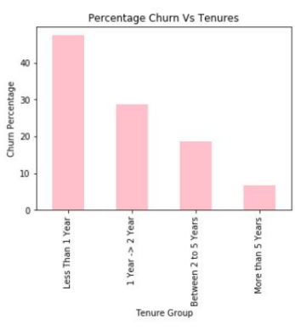
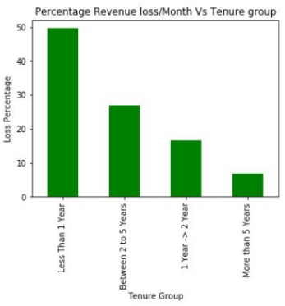
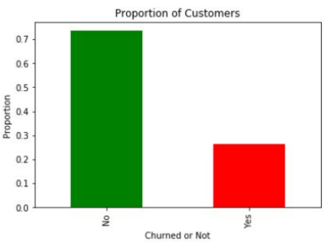
Business Problem visualization
26.54% Churn rate overall
$139K loss per month / 1.67M loss per year, about 30% of the total income
Less than a year tenure category has highest churn and result in highest revenue loss
2-to-5-year tenure category results in highest revenue loss

Slide 6

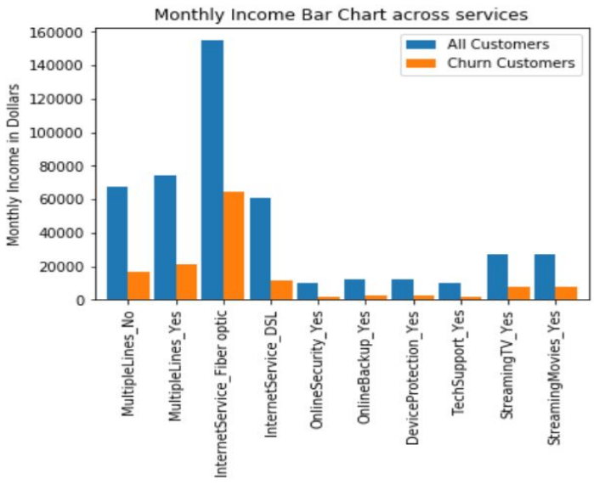
Data Stories: Monthly Charges Split by Services
The height of the bar = count of people subscribed * Charge as per rate table of previous slide
Blue bars are from the entire 7043 rows
Orange bars are from the Churn group
The importance of Fiber Optic Service on the Monthly Income is very clear!
MulipleLines_No essentially means Phone Line Single

Slide 7
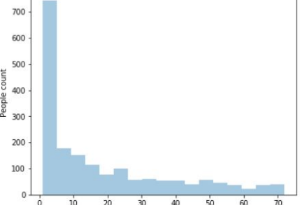
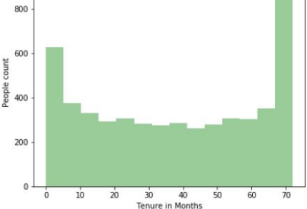
Data Stories : Tenure in Months
Fig 1: Drop from bin 70 to bin 60 => Huge churn happened about 5.5 years ago.
Fig 1: Between 10 to 60 months, not much variation => Once they cross a year, they remain loyal
Fig 2: High count in first bin, drastic drop=> Most in churn group < 5 months tenure

Slide 8
Predictive Modeling
Acceptance Criteria:
○ Train and Test Accuracy approx equal or not.
○ “Recall” on the Churn class to be higher priority than overall accuracy
Data Prep/Feature Selection :
○ Drop numerical variable Total Charges, and Monthly Charges
○ Drop the column Phone Service, as it is a subset of Multiple Lines
Data split to Train : Test ratio 60:40 , stratified with target
Hyperparameter tuning done using 5-fold cross validation(CV) method on Training data
Score function used in CV is “Recall”

Slide 9
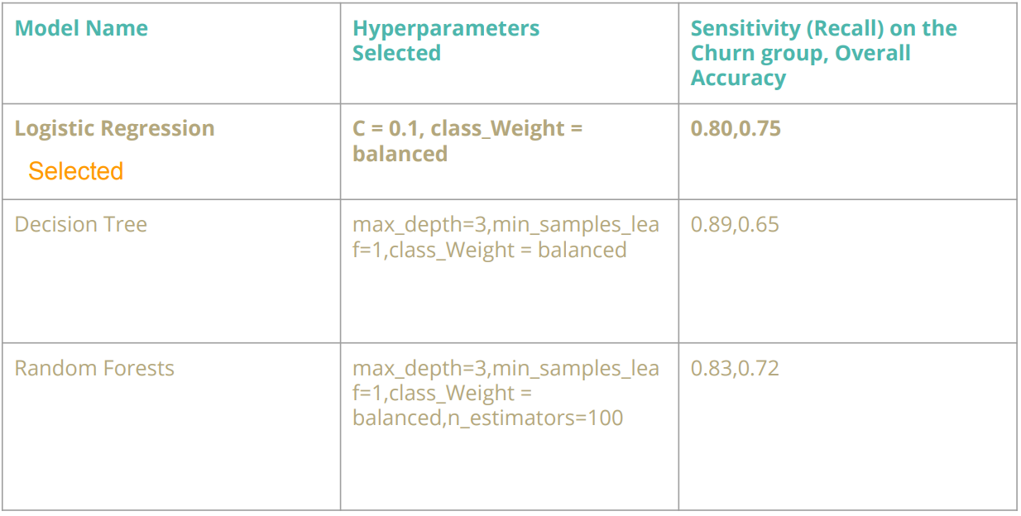
Comparison of Models Tried

Slide 10
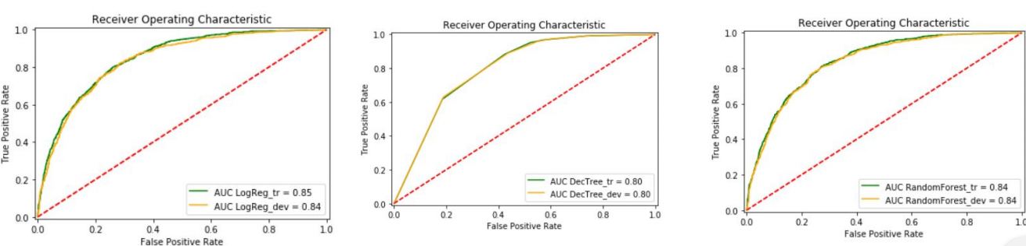
Comparison of Results, ROC Plots
Which one to choose: I would choose Logistic Regression because,
○ It is faster and less complex
○ More interpretable for this problem, gives coefficients with signs
○ It gives better overall accuracy than Random Forest, and almost same recall on Churn class

Slide 11
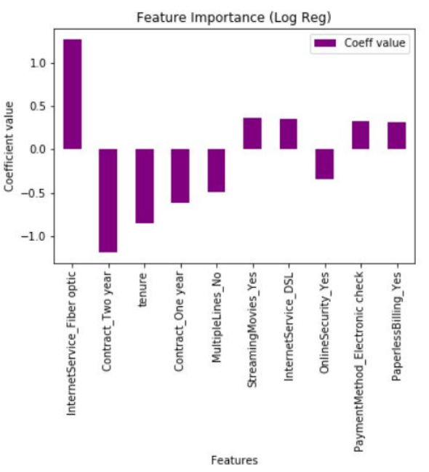
Feature Importance Based on Logistic Regression
Top 10 Features with their influence shown
● Interpretation:
○ Features with negative coefficients are favorable, and positive not favorable

Slide 12
Solutions Proposed
A predictive model is given that ranks customers based on their probability of churn and the revenue that they bring - (not just the probability)
Use this model to prioritize whose concerns to be addressed first. Sometimes it might be case by case basis. ●
Take the following actions immediately:
○ Try striking a longer contract with new customers: two year or one year in that order of preference.
○ Leverage the time to improve the quality of services, of the high cost ones like Fiber optic.
○ Improve on the Technical support on all services like streaming, phone connection and internet.
○ Be up-to-date with current technology.
Next: It will be helpful to understand why churn started 5.5 years ago. Give more historical data to the data scientist for analysis.
The income loss prevented using the given dataset: $114,422 / month or 1.38M per year if all of them change their mind.

Slide 13
References/Links 1
IBM page has many, out of that this Telecom dataset
Introduction to Statistical Learning by Gareth James et. al
Predicting Customer Churn using R by Susan Li
Techniques to Handle Imbalance by Jason Brownlee

